Slide 1
MECHANICAL TEAM WEEK 4 PROGRESS REPORT
TEAM
CLINTON TITO
IAN MUTISYA
CATHERINE KIPKAZI
ISAAC NGUGI
KENNEDY OUMA
PETER NZIOKI

Slide 2
PREVIOUS DESIGN CHALLENGE
Had thick plates which was later realized to increase the weight the motor mount
Use of plates on the sides obstructed air flow hence reducing cooling efficiency

Slide 3
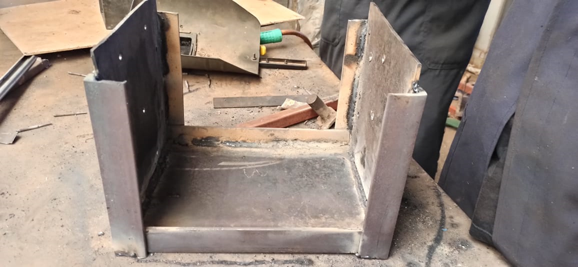

Slide 4
WHY NEW DESIGN
More cooling efficiency
Lighter due to less materials as compared to the previous design

Slide 5
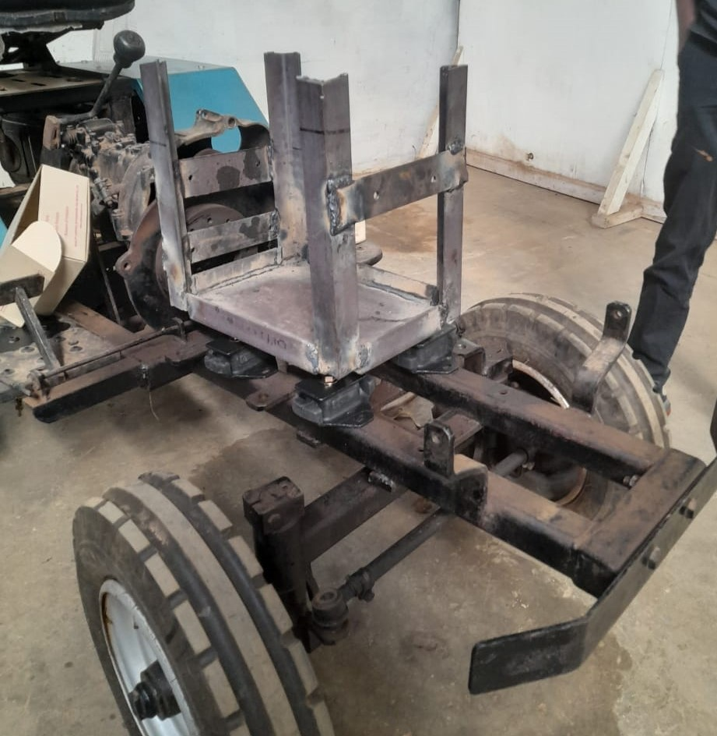
MOTOR MOUNT WITHOUT THE MOTOR

Slide 6
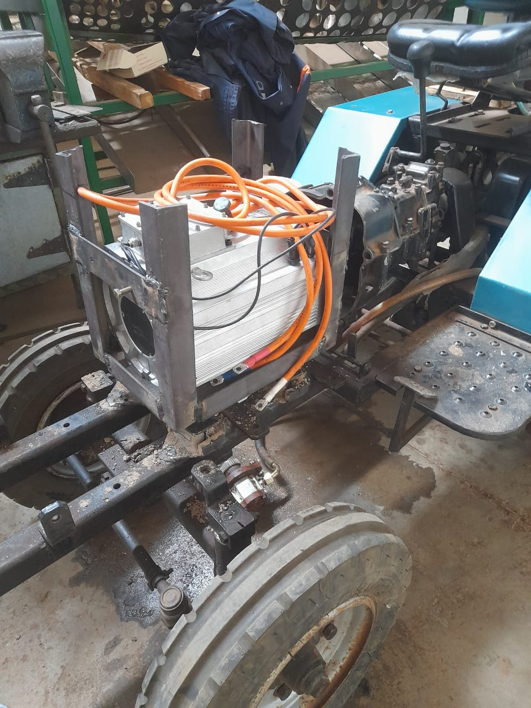
SIDE VIEW

Slide 7
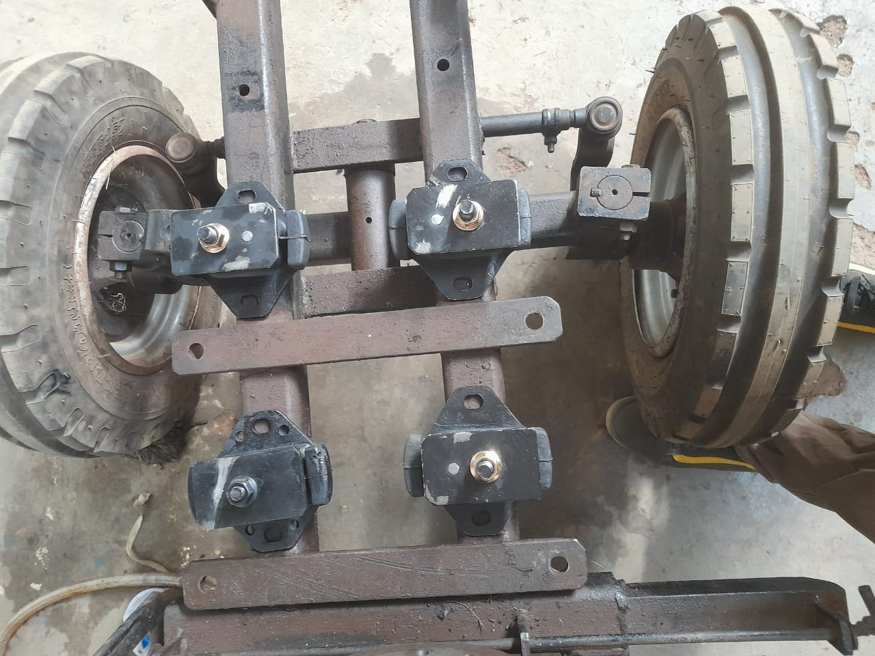
RUBBER MOUNT ON THE CHASSIS

Slide 8
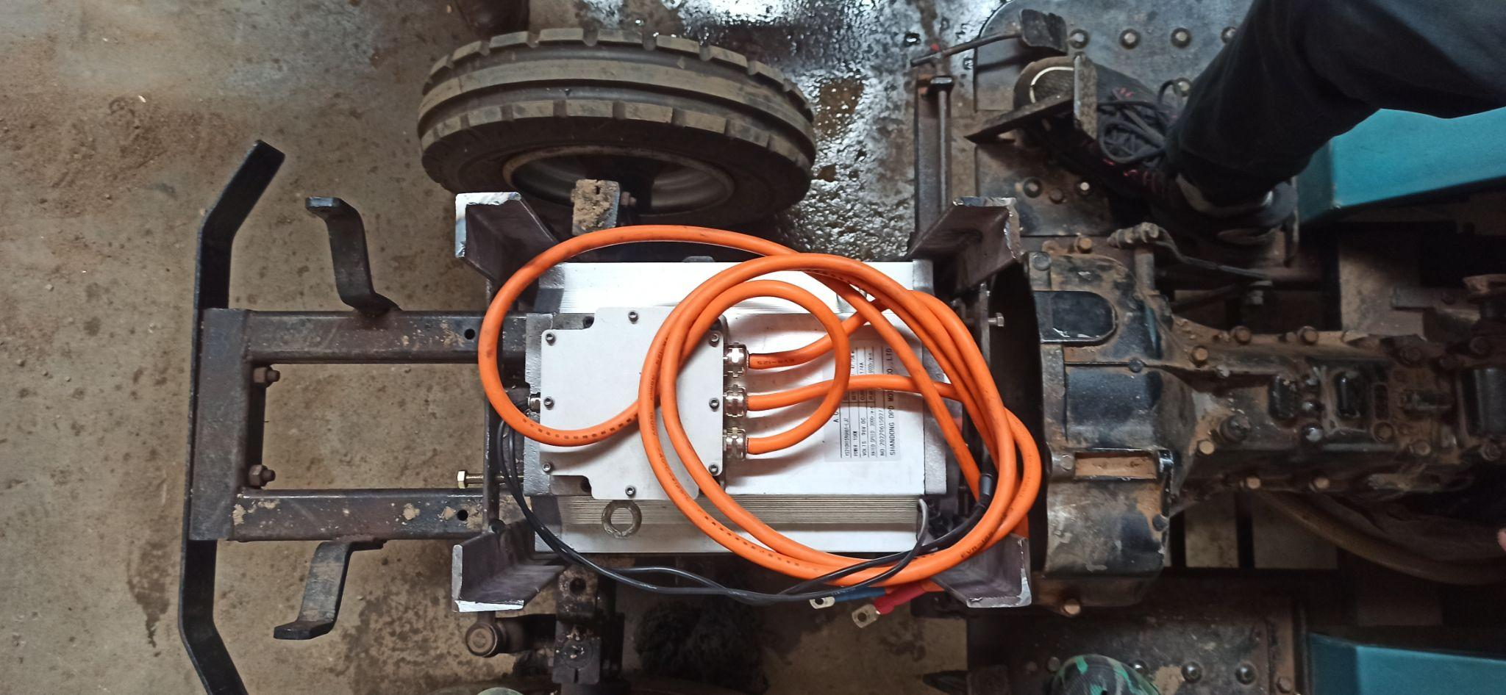
TOP VIEW

Slide 9
FLYWHEEL COUPLING PURPOSE
To transmit power from motor to the gearbox

Slide 10
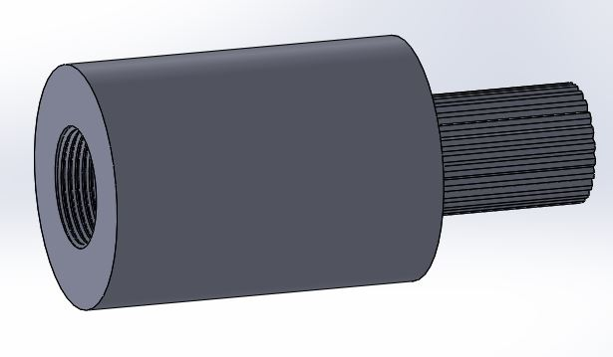
FLYWHEEL COUPLING CAD DESIGN

Slide 11
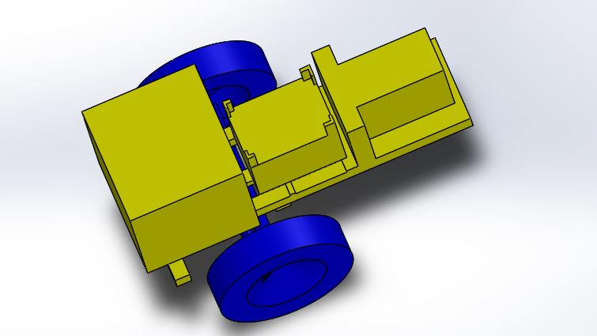
TRACTOR 3D CAD REPRESENTATION

Slide 12
THANK YOU
🤗

